Slide 1


Amazon REVIEW CLASSIFICATION

Slide 2
Submitted to :
Ms. Beebi Naseeba
School of Computer Science and Engineering
Submitted by :
Shaik Mohammad Waseem Akram – 20BCD7141
Pabbisetty Revanth Venkata Sai – 20BCI7009
Panyam Venkatesh – 20BCI7062

Slide 3
INTRODUCTION
Classifying Amazon reviews based on customer ratings using NLP
Reviews provide objective feedback to a product and are therefore inherently useful for consumers. These ratings are often summarized by a numerical rating, or the number of stars. Of course there is more value in the actual text itself than the quantified stars. And at times, the given rating does not truly convey the experience of the product – the heart of the feedback is actually in the text itself. The goal therefore is to build a classifier that would understand the essence of a piece of review and assign it the most appropriate rating based on the meaning of the text.
Even though Amazon’s helpfulness rating system seems to work on the surface level, poor quality comments still seem to be at the top of their review forms. Having poor quality reviews hurts Amazon’s business, as a major reason that people are willing to buy consumer goods on-line without seeing the items themselves, is that they have access to others peoples opinions of the item.

Slide 4
ABSTRACT
Sentiment Analysis (SA), which is also known as Opinion Mining, is a hot-fastest growing research area, making it challenging to follow all the activities in such areas. It intends to study people's thoughts, feelings, and attitudes about topics, events, issues, entities, individuals, and their attributes in social media (e.g., social networking sites, forums, blogs, etc.) expressed by either text reviews or comments. Amazon is an example of the world's largest online retailer that allows its customers to rate its products and freely write reviews. Analysing these reviews into positive or negative; will assist customers' decision making, which varies from purchasing a product like a camera, mobile phone, etc., to writing a review about movies and making investments - all of these decisions will have a significant impact on the daily life. Sentiment analysis draws the attention of both scientific and market research in Natural Language Processing and Machine Learning fields. In general, the machine learning approach consists of supervised and unsupervised algorithms. In this research study, a detailed typical workflow process often adopted by the researchers is presented. Moreover, traditional supervised machine learning classification techniques have been investigated on various categories of Amazon product reviews to find the best method that provides a reliable result of sentiment analysis and assists future research in this newly emerging area.

Slide 5
Existing Problem
Customer Reviews help customers to learn more about the product and decide whether it is the right product for them.
Customer Reviews should give customers genuine product feedback from fellow shoppers. We have a zero tolerance policy for any review designed to mislead or manipulate customers.
We do not allow anyone to write reviews as a form of promotion.
The following are types of reviews that we do not allow and will remove:
A review by someone who has a direct or indirect financial interest in the product.
A review by someone perceived to have a close personal relationship with the product's owner, author or artist.
A review by the product manufacturer, posing as an unbiased shopper.
Multiple negative reviews for the same product from one customer.
A review in exchange for monetary reward.
A review of a game in exchange for bonus in-game credits.
A negative review from a seller on a competitor's product.
A positive review from an artist on a peer's album in exchange for receiving a positive review from them.

Slide 6
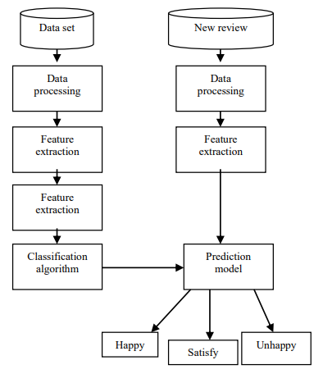
dataset
Top sentiment analysis datasets
Sentiment analysis is an increasingly popular topic in social media because it can be used to identify the tone and attitude of posts, and to thus analyze customer satisfaction, for example.
Several datasets are available that prove useful for sentiment analysis, though some are more high-quality and insightful than others.

Slide 7
Proposed work
It’s no secret that product reviews and ratings play a pivotal role in Amazon SEO. The better the product rating, the better its organic ranking. While many sellers understand why reviews are important, they often find it difficult to get honest feedback from their customers.
Are you struggling to get Amazon product reviews? Are your customers not taking the time to leave valuable feedback?
Don’t worry. It is a common roadblock for many sellers early on. That’s why we’re revealing all the tricks that the pro sellers use to get quality product reviews on Amazon. Here are the best and legal ways to get product reviews on Amazon quickly.

Slide 8
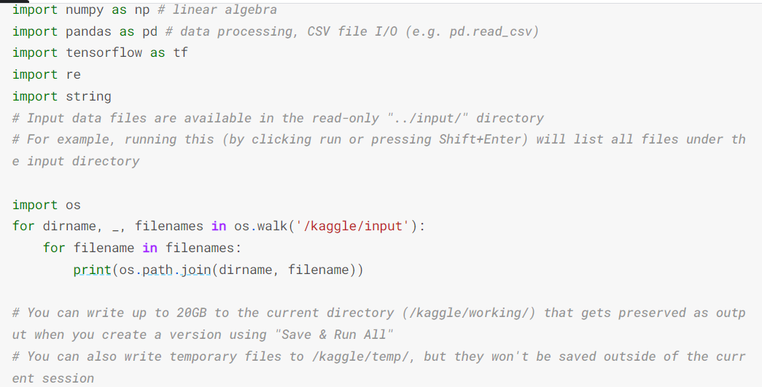
code

Slide 9
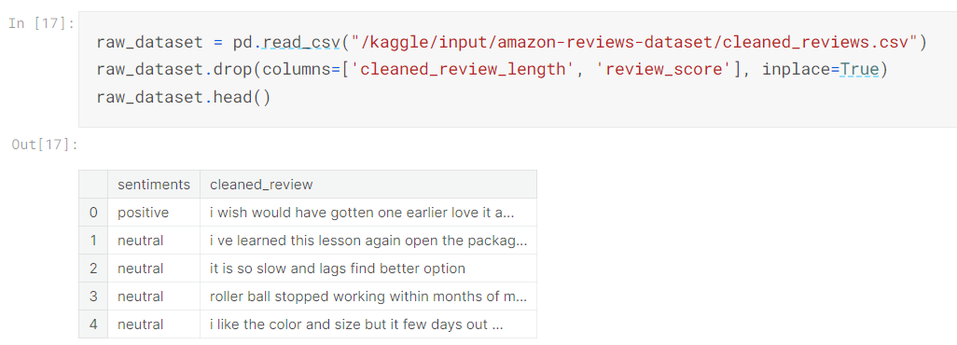
Load Dataset

Slide 10
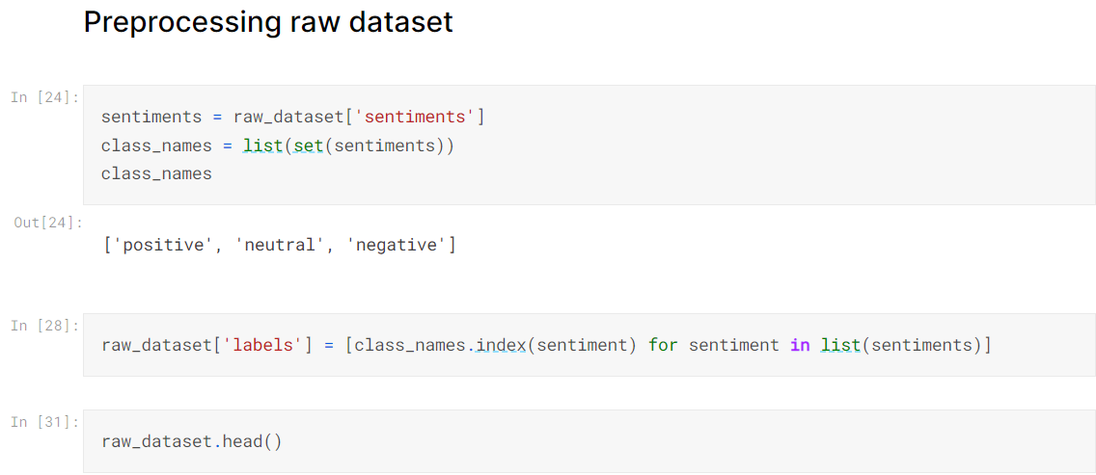
Load Dataset

Slide 11
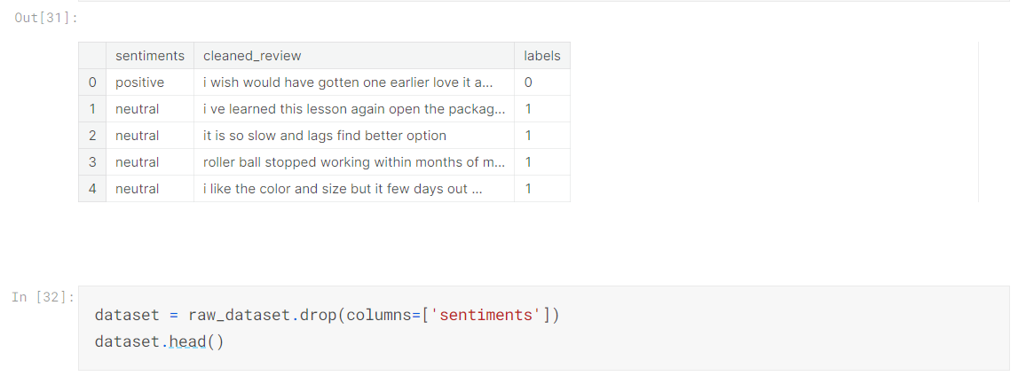
Load Dataset

Slide 12
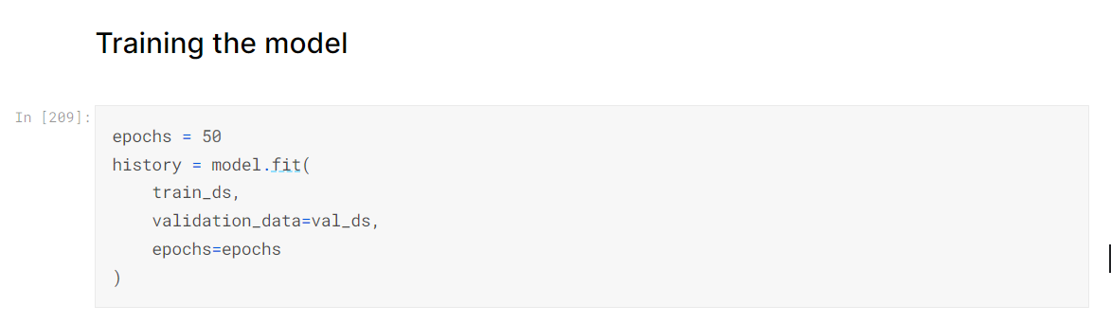
result

Slide 13
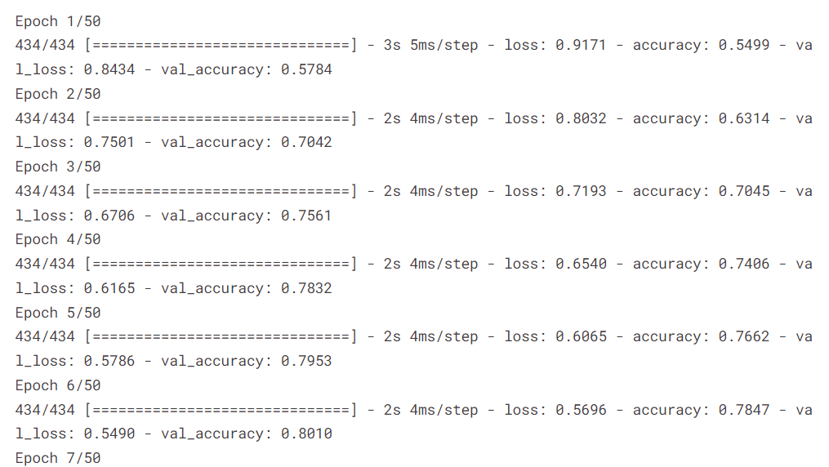
result

Slide 14
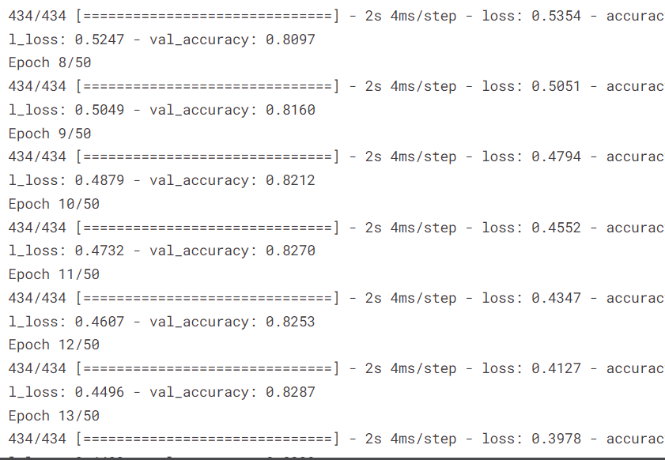
result

Slide 15
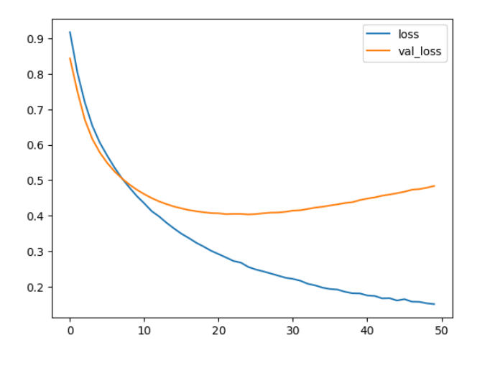
CONCLUSION
summary of the problem solution is as follows: Our model takes in existing 'reviewText' and transforms it into numerical TF-IDF scores. It then adds the existing 'overall' score of the reviews to create a features set for each review.
It trains a Logistic Regression model using labels generated by taking existing 'helpfulness_numerator' data and dividing it by 'helpfulness_denominator' data and thresholding the result at 0.5. It then takes in new reviews with no helpfulness data from user ratings and attempts to classify them as being 'helpful' or 'non-helpful’.
By using this system, Amazon can work to make sure than more 'helpful' reviews are shown at the top of their forums

Slide 16
IMPROVEMENTS
In order to improve the accuracy of our model, the following actions could be taken:
Perform more feature engineering, such as proper spell checking for the reviews. This would result in a model that potentially has less features, as certain spelling errors would have been corrected/eliminated.
Explore the effect of not doing pre-processing on the reviews. Reviews with poor grammar, and punctuation and improper word endings are more difficult to understand and would possibly lead to people rating them as less helpful. During our project, we did this pre-processing in order to make the algorithms work better; however, maybe feature reduction should have been done in a different way to order to preserve the "incorrect" information.

Slide 17
REFERENCE
Inferring networks of substitutable and complementary products. J. McAuley, R. Pandey, J. Leskovec Knowledge Discovery and Data Mining, 2015.
Image-based recommendations on styles and substitutes J. McAuley, C. Targett, J. Shi, A. van den Hengel SIGIR, 2015.
HUI BWU Y. Anti-spam model based on semi-Naive Bayesian classification model. Journal of Computer Applications. 2009;29(3):903-904.
Liaw A. Weiner M. Classification and Regression by randomForest. R News. 2002;Vol 2(2):18-22.
https://www.kaggle.com/datasets/bittlingmayer/amazonreviews
https://www.kaggle.com/datasets

